Slide 1
Linear & Logistic Regression

Slide 2
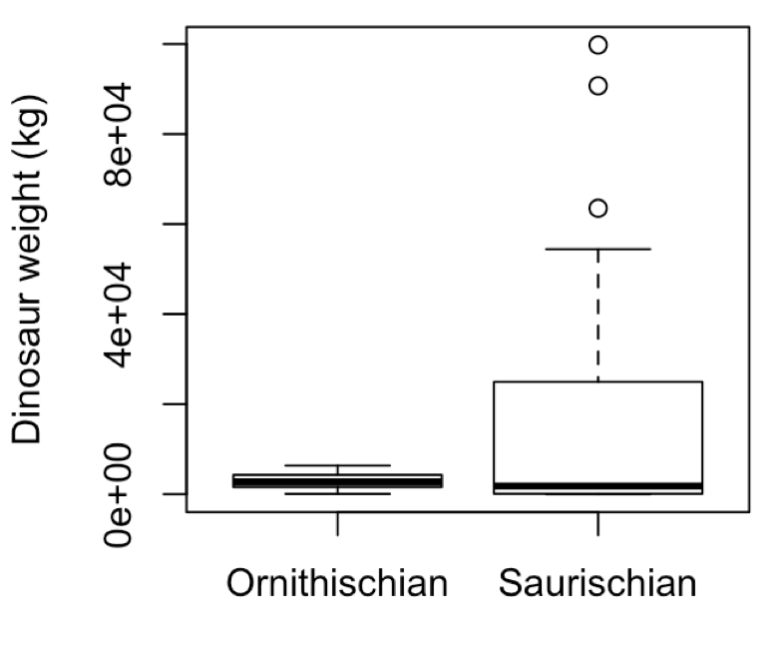
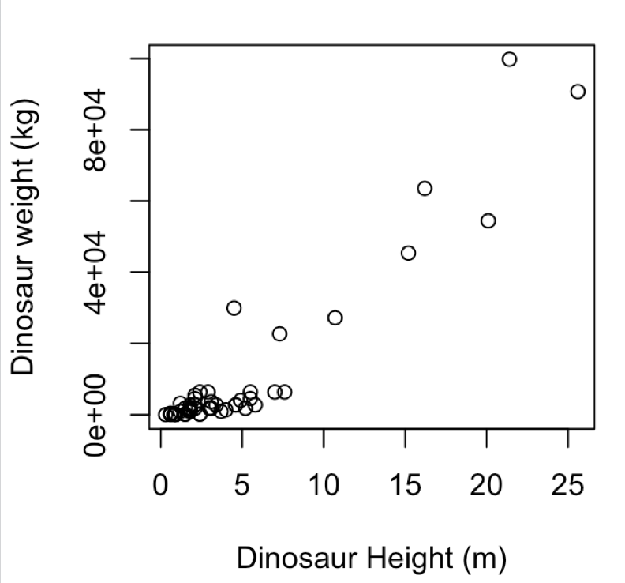
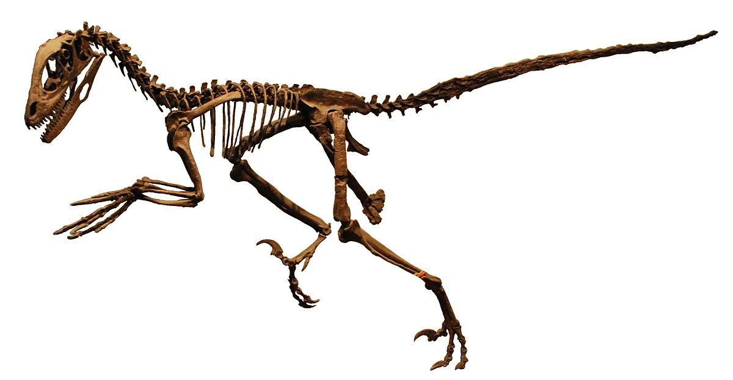
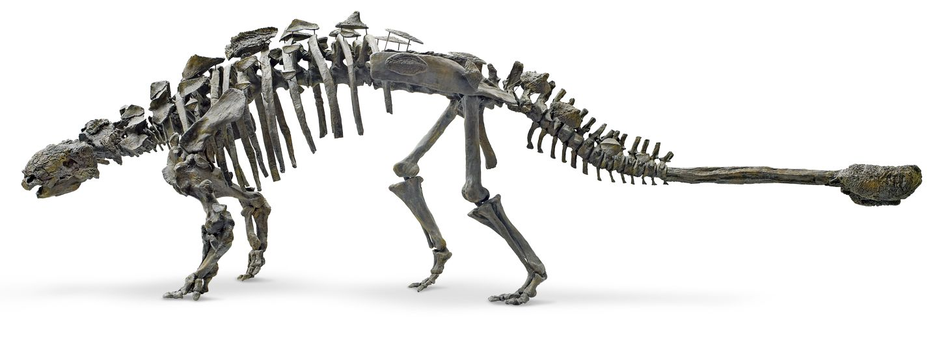
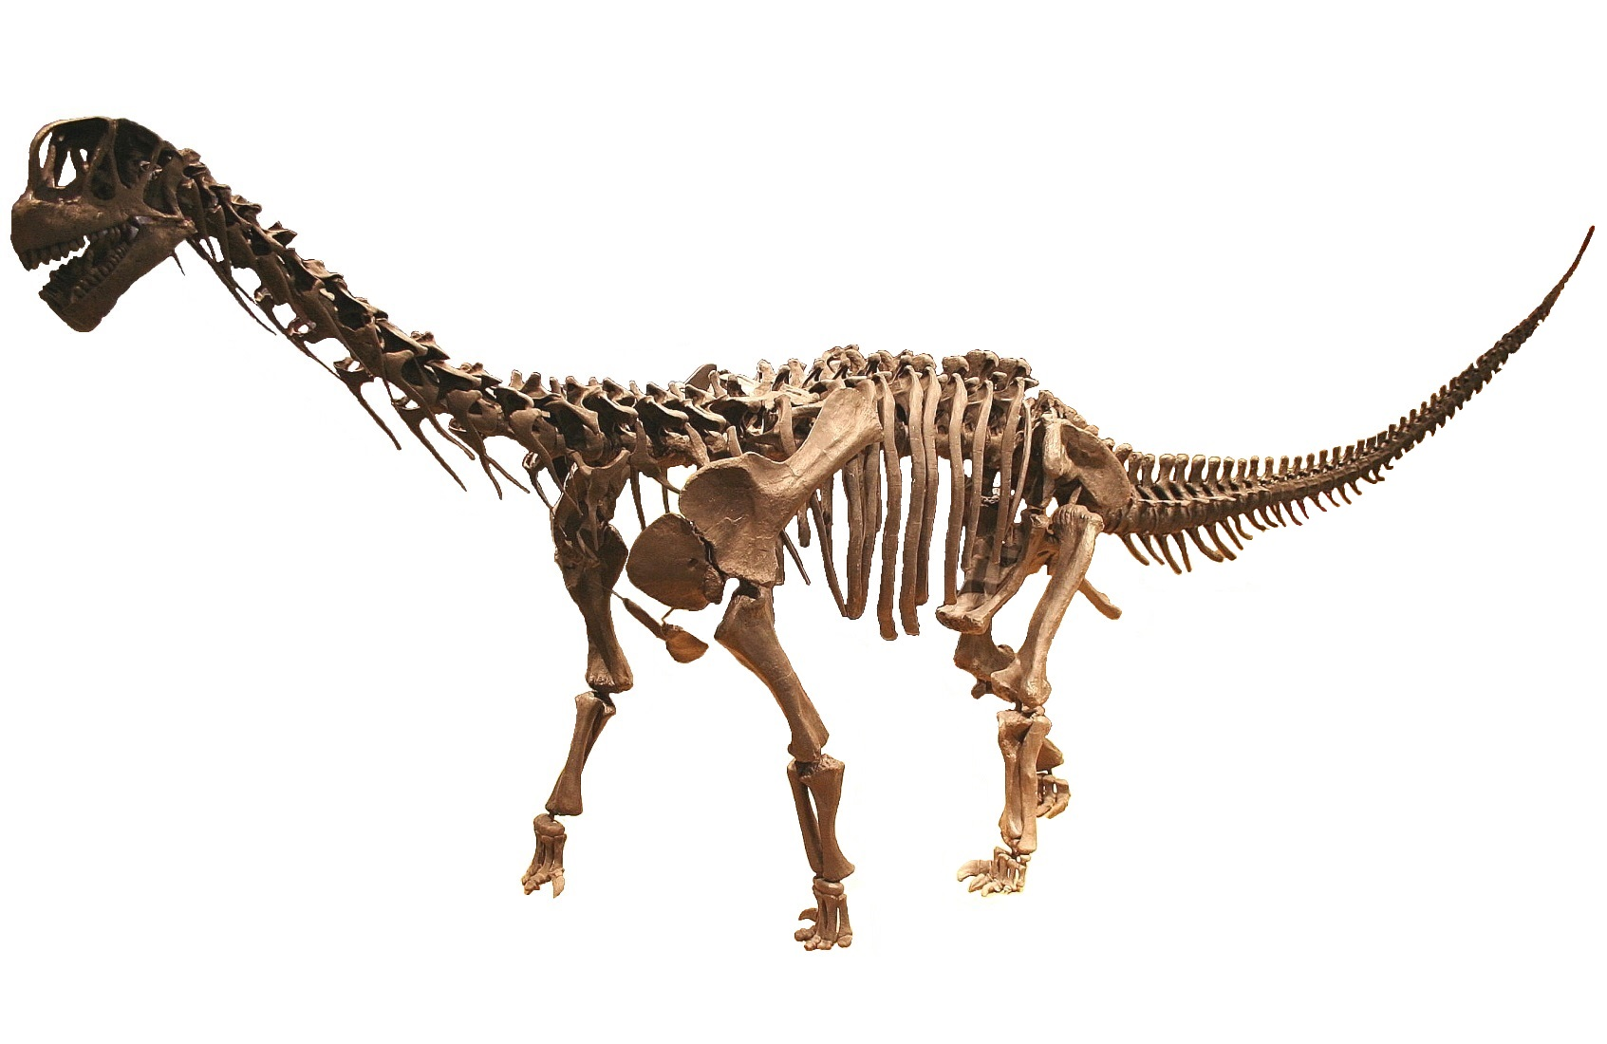
Linear & Logistic Regression
Regression
What is the relationship between dinosaur height, length and weight? Can we predict weight for a new specimen of a given size?
Classification
Is there a relationship between a dinosaurs (sub)order and its size? Can we predict the the dinosaurs order given just measurement of its size? What about other features? Could we predict a dinosaurs order from the topology of its bones?
Feature selection: can we identify a subset of explanatory variables that best explain the observation variables

Slide 3
Supervised learning
Learning from a set of (manually) labelled data
e.g. a tuple of observations (X,y)
Regression:
X represents the explanatory variables. Commonly a (n x S) matrix of real-valued inputs, where S is the number of variables and n the number of observations, and y = (y₁, … , y_{n})ᵀ a column vector of real valued output variables.
Logistic regression:
X is a real-valued input and y is a binary output
Goal is to learn the function that maps from X to y AND predict the values of y* at new locations X*

Slide 4
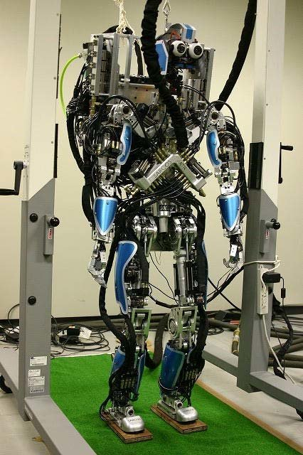
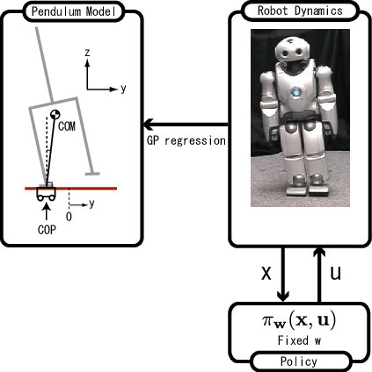
Use regression approaches to train / optimise robotic movements
https://ieeexplore.ieee.org/document/4399485

Slide 5
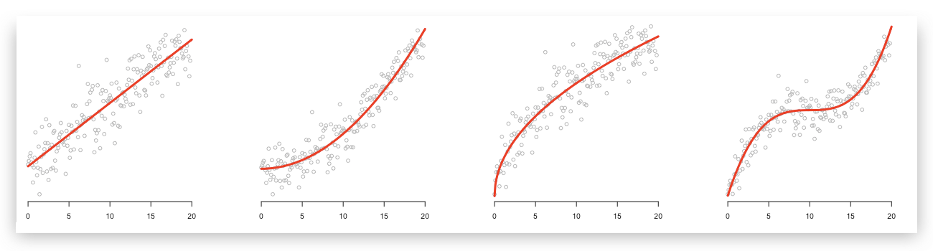
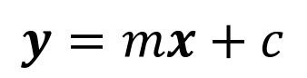
Linear regression
R PSEUDOCODE
$$y=mx+c$$
lrfit <- train(y~., data, method = "lm")

Slide 6
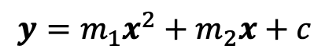
Polynomial regression
R PSEUDOCODE
$$y=m_{1}x^{2}+m_{2}x+c$$
lrfit3 <- train(y~poly(x,degree=2), data, method = "lm")

Slide 7
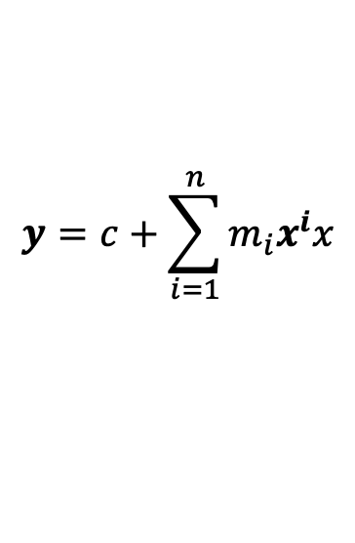
Polynomial regression
$$y=c+\sum_{i=1}^{n}{m_{i}x^{i}x}$$
R PSEUDOCODE
lrfit3 <- train(y~poly(x,degree=n), data, method = "lm")

Slide 8
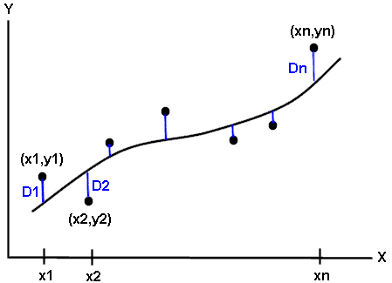
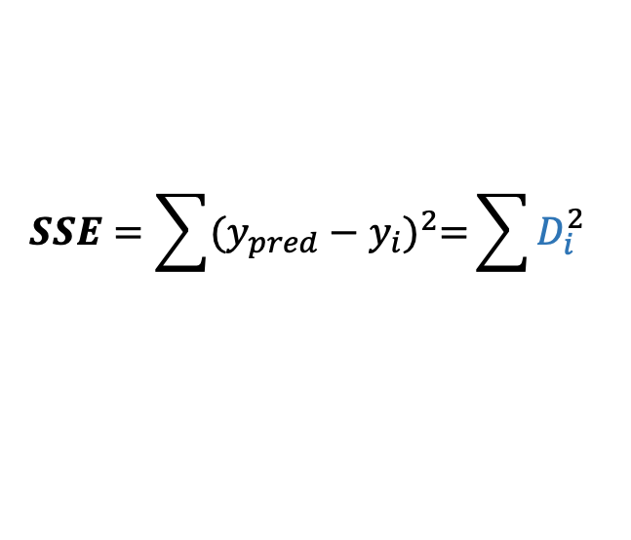
Evaluating performance
Split the data: training / (validation) / test
Calculate appropriate metric e.g. sum squared error:
Why? We want an objective way to measure if a model is truly learning about the system or simply interpolating through the data
Too simple a model won’t have the descriptive power to explain the observations (underfitting)
Too complex a model will be able to describe the training data very well, but won’t generalise to the test data (overfitting)
$$SSE=\sum{{(y_{pred}−y_{i})}^{2}=}\sum{D_{i}^{2}}$$

Slide 9
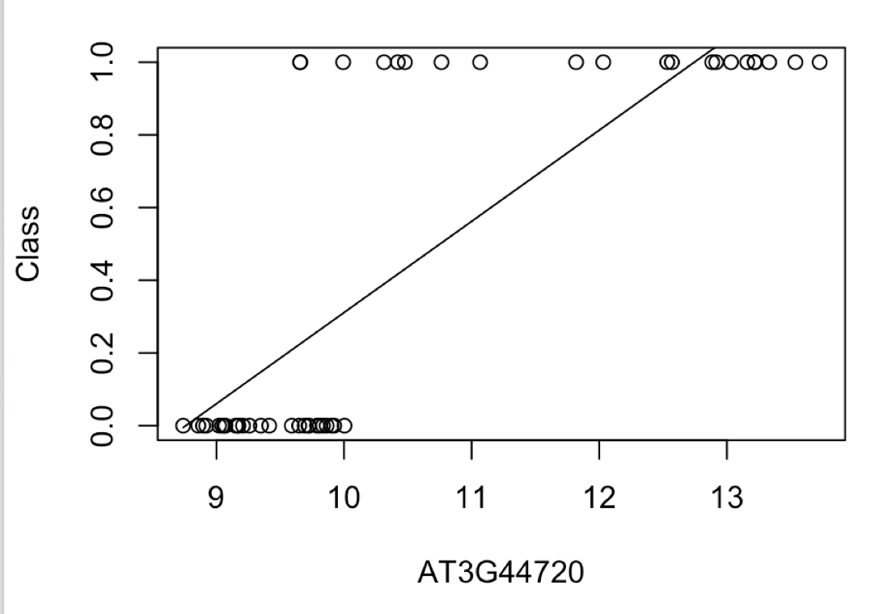
Logistic regression
Binary valued outputs, y, so linear regression is no good!
y
Input variable

Slide 10
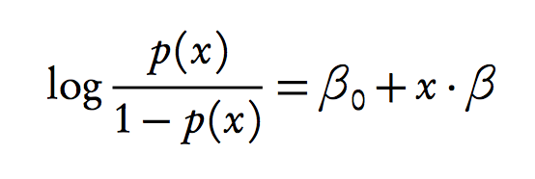
Logistic regression
Binary valued outputs, y, so linear regression is no good!
y
Model probability of success
Input variable

Slide 11
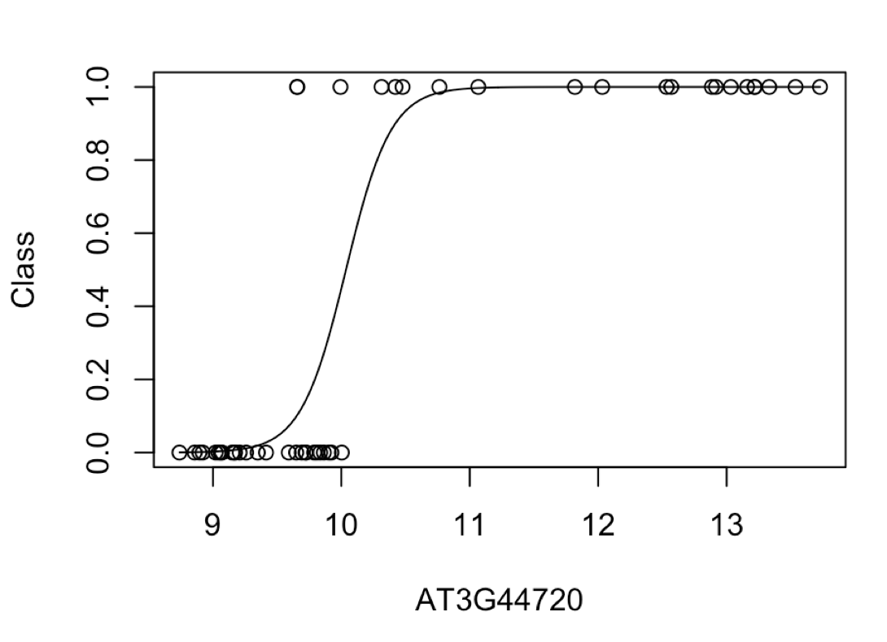
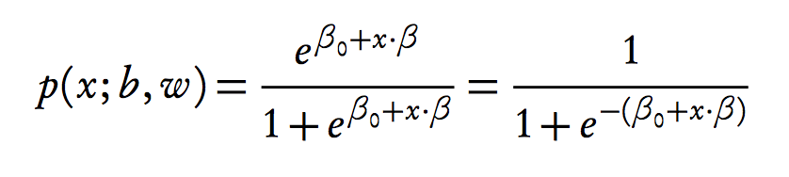
Logistic regression
Binary valued outputs, y, so linear regression is no good!
y
Model probability of success
Input variable
Solve for x

Slide 12
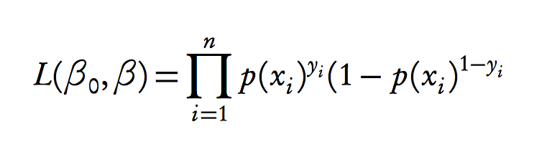
Logistic regression
Binary valued outputs, y, so linear regression is no good!
y
Model probability of success:
Input variable
Solve for x:
Likelihood:
(choose parameters
to maximise this)

Slide 13
Logistic regression
Binary valued outputs, y, so linear regression is no good!
y
Model probability of success
Input variable (x)
Solve for x
R PSEUDOCODE
lrfit <- train(y ~ ., data, method="glm", family="binomial")
Likelihood
(choose parameters
to maximise this)

Slide 14
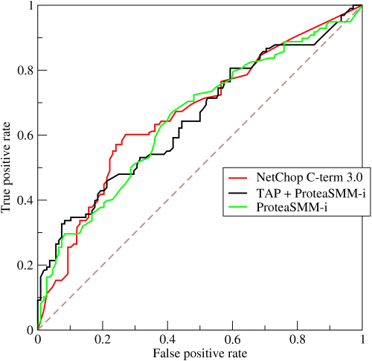
Evaluating performance: Receiver operating characteristics (ROC)
Sum of squared error is a poor choice for performance
Can predict the probability that y = 0 or y = 1. Take a threshold e.g., p(x=1) > 0.5
Can count the number of correct/incorrect classifications.
True positive: Predict y = 1, observation y = 1.
True negative: Predict y = 0, obs. y = 0.
False positive: Predict y = 1, obs. y = 0.
False negative: Predict y = 0, obs. y = 1.
Plot false positive rate (FPR) versus true positive rate (TPR):
TPR = TP/(TP+FN)
FPR = FP/(FP+TN)
Area under the ROC curve (AUC)
Area under Precision-recall (PR) curve

Slide 15
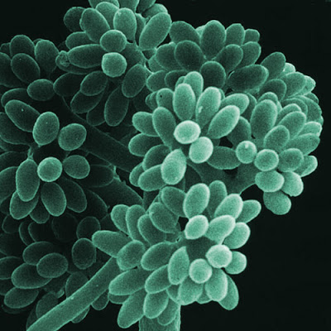
Tasks
Use linear regression to analyse Arabidopsis thaliana gene expression time series data following inoculation with the necrotrophic fungus Botrytis cinerea
Use logistic regression to look for marker genes that are indicative of infection status

